Slide 1

Loss Aversion
The science
By Timothy Allen 2023

Slide 2
Overview
“Losses loom larger than gains”
The cornerstone theory
Importance of reference points
Real world use

Slide 3
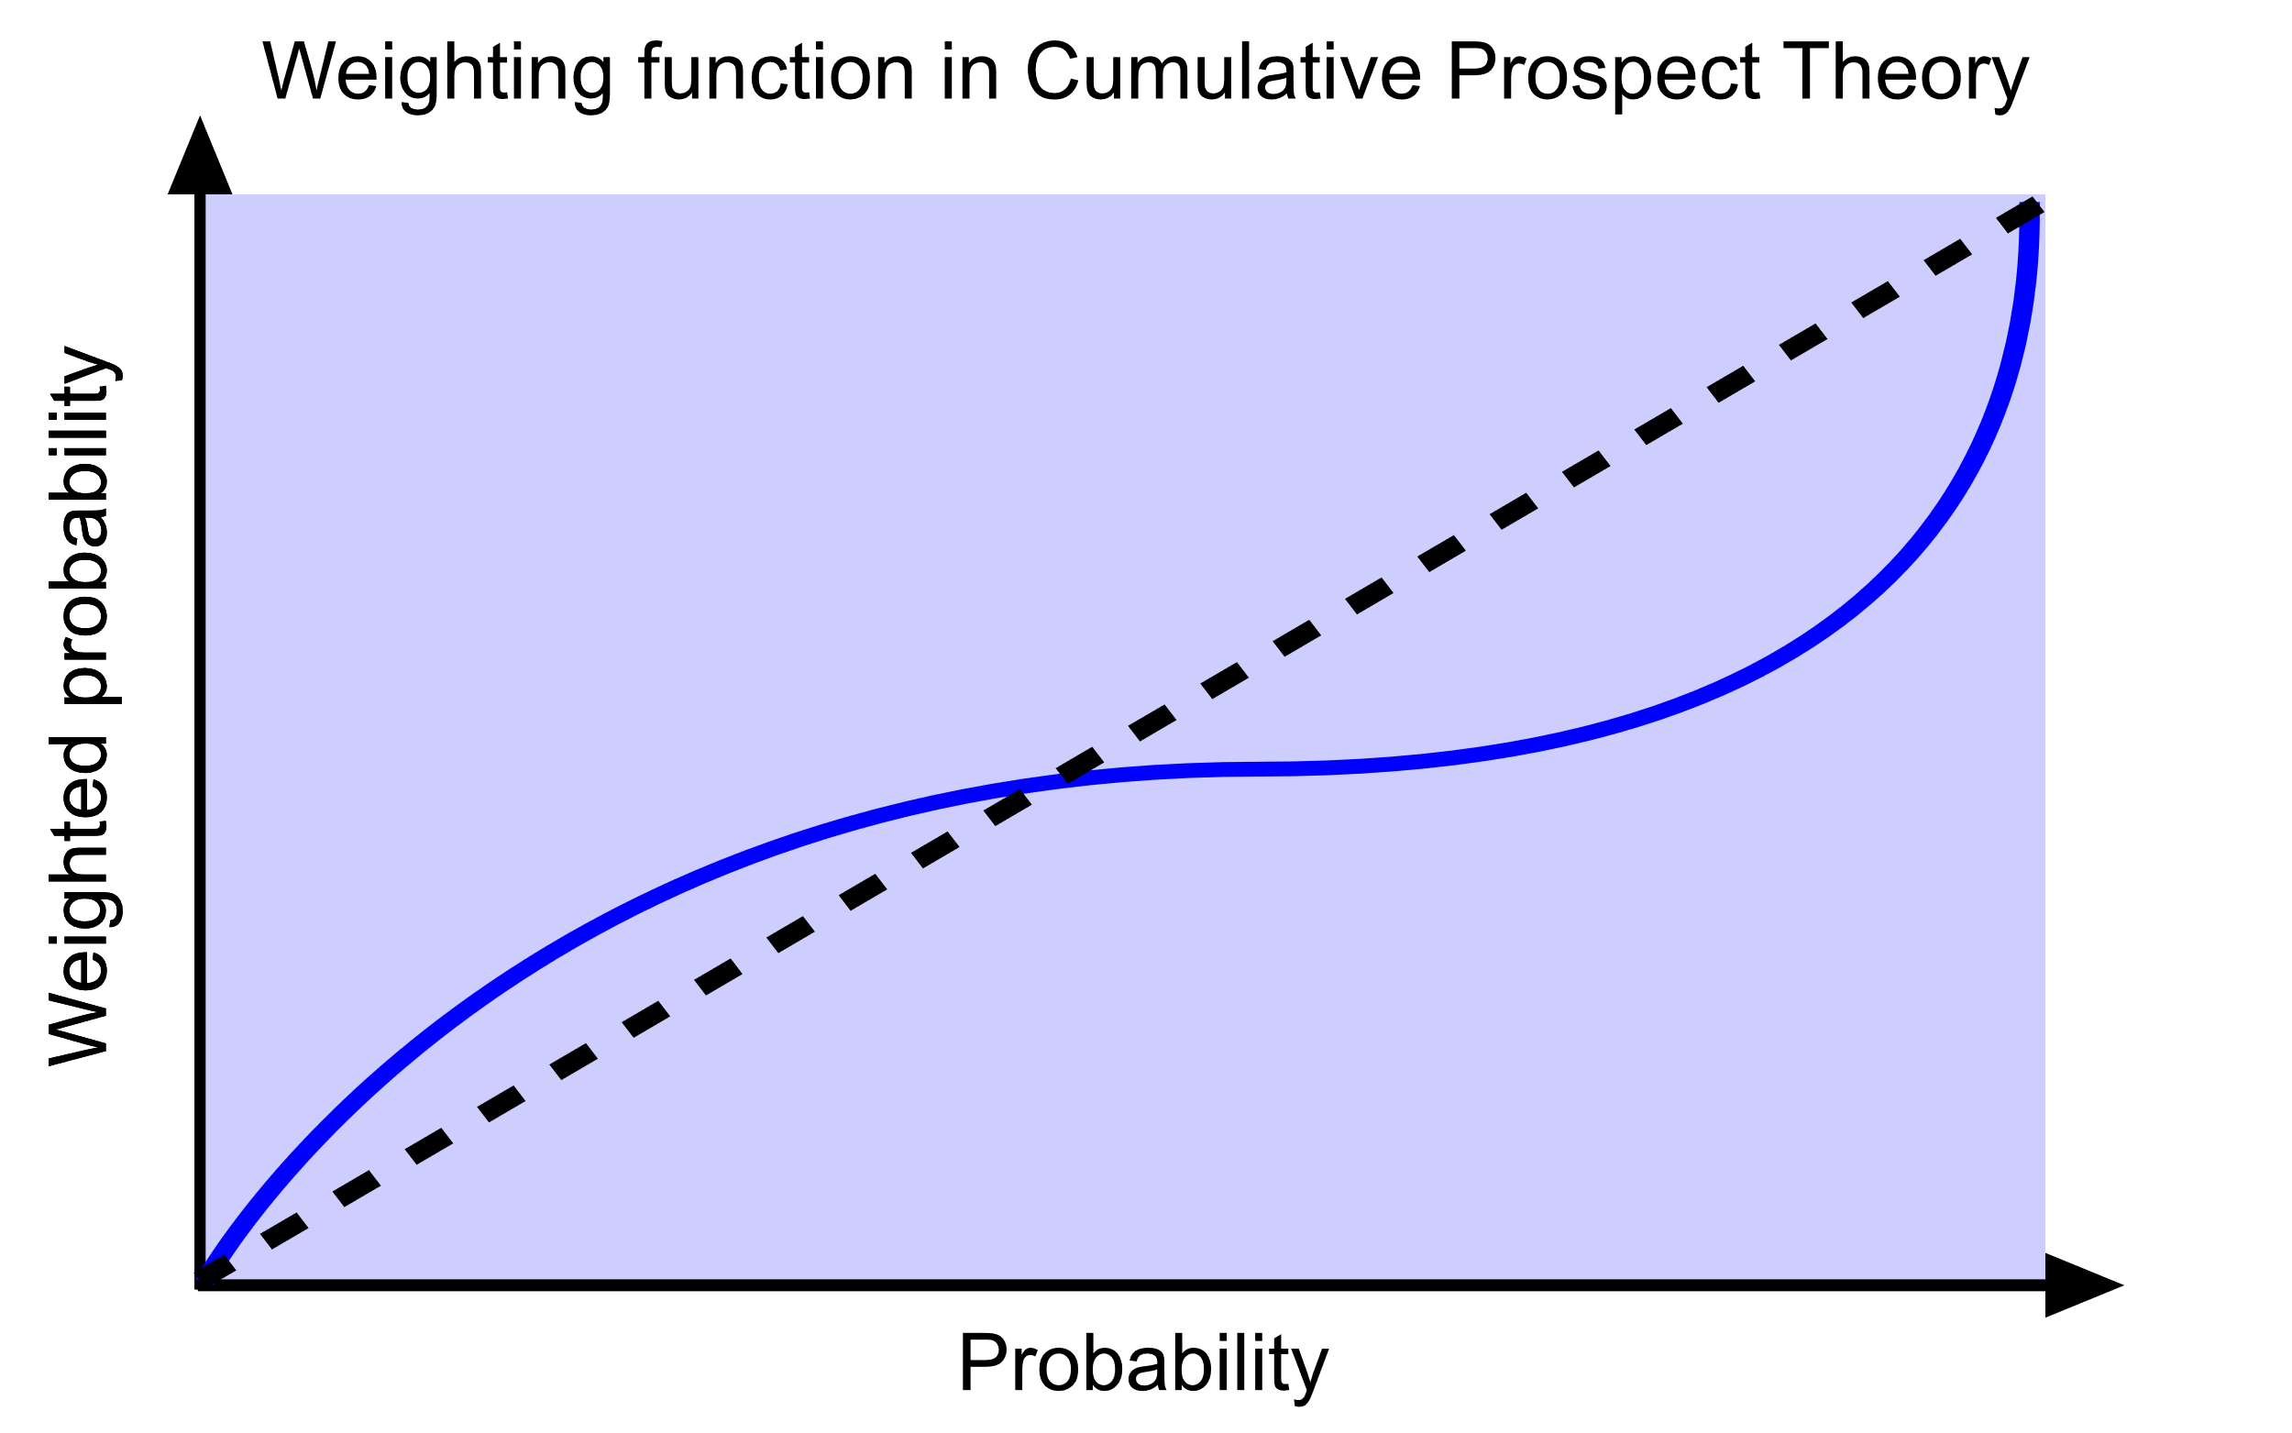
Cumulative prospect theory
Origins with utility theory
Weighting function
By Pharexia - Own work, CC BY-SA 4.0, https://commons.wikimedia.org/w/index.php?curid=78789278

Slide 4
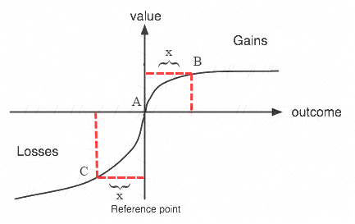
Reference dependence
Status quo bias
Endowment effect
Aside: price setting
By ValunFunProspectTheory.png: *Valuefun.jpg: Rieger at en.wikipediaderivative work: JohnKiat (talk)derivative work: JohnKiat (talk) - This file was derived from: ValunFunProspectTheory.png:, CC BY-SA 3.0, https://commons.wikimedia.org/w/index.php?curid=18600998

Slide 5

Real world applications
Equity premium puzzle
Behavioural economics

